Slide 1


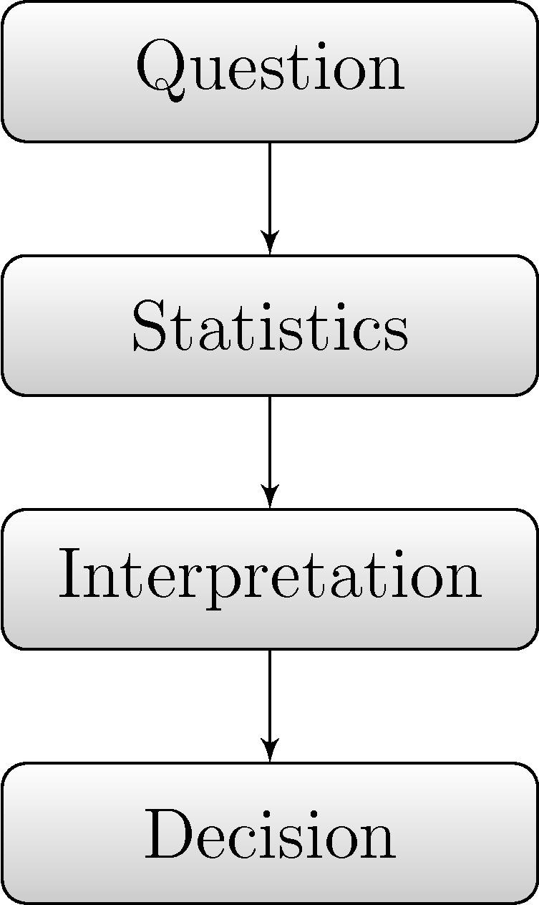
Topic- Statistical Investigation
EQ- What are the requirements to produce an outstanding statistical investigation?

Slide 2


Aim: to produce, analyse and compare data in the form of a dot plot, histogram or stem and leaf plot.
Choose a topic or question that you can collect data for. Ideally this will be a question that is really interesting and relevant to you.
Design a survey to collect primary data.
Primary data- using methods like surveys, interviews, or experiments.
Compare your primary data with secondary data.
Secondary data- data collected by someone other than the researcher such as census information and government reports.

Slide 3

Assignment Product
You (up to 3 in a group) will be required to submit a poster (up to A1 in size).
Must be able to be read from a distance of 2 metres
The poster may be digital or hard copy.
Hypothesis and background information.
Organised primary and secondary data (including source/s)
Data represented graphically
Analysis of data (centre and spread)
Discussion of findings
Conclusion
References

Slide 4




This years topic!
The use of Technology!

Slide 5
https://ssapostercomp.info/resources.shtml
Jessie Roberts explains how diverse and useful the field of statistics is.
This diversity can be a tool when planning your investigation.

Slide 6
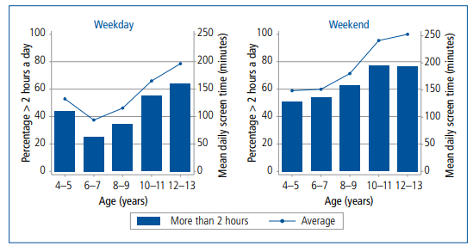
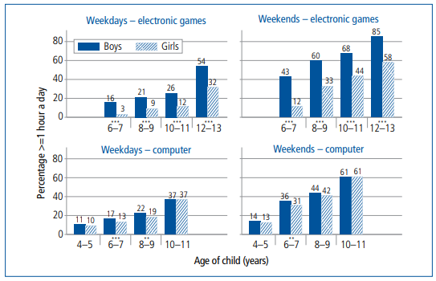
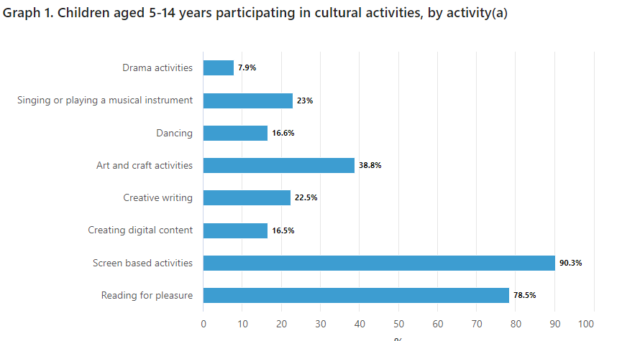
Sourcing Secondary Data

Slide 7
Sourcing Secondary Data
Resources to get you started with your research will be available on Connect.
However you are required to do you own research to find reliable and relevant data.
The internet will be your best tool here!
The Australian Bureau of Statistics, Government Departments or websites that contain the .org or .edu domain.
You may wish to extend yourself and compare groups such as gender, states in Australia or even finding data from Asia!

Slide 8
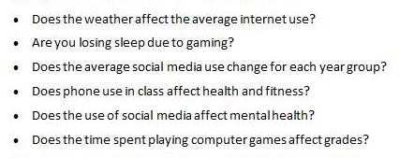
Questions to guide your thinking.

Slide 9
Left Hand Side Activity
Technology
Rule your page into thirds.
In the top third.
You have one minute to brainstorm all the technology that you can think of. Be prepared to share your answers.
In the middle third.
You have three minutes to write down how you may use technology in your social life and for emotional and physical wellbeing.
In the final third.
Write 5 questions that you may be interested in researching.
Social
Emotional
Physical

Slide 10
You have 3 minutes to organise yourself to work individually in a pair or group of 3
Compare the brainstorm that you have completed.
Highlight any similar words in each of the three sections.
The assessment counts towards your grade but will also but will also be submitted into a national competition.
The competition has prizes that you can win and rules you must follow (all available on Connect).

Slide 11
Hints and tips for designing a good statistical investigation.
Data collected must be numerical.
Make sure your research and hypothesis includes “Technology”
Before committing to a question or theme, ensure there is sufficient secondary data to compare the data you collect.
Whilst collecting primary data look for opportunities for bias.
Understand how you can use your statistical investigation to compare, contrast and graphically represent your data.

